Slide 1


Break Through Tech AI Studio
KPMG LLP US
August 2024
Notes:
Why this slide is important:
Sets the stage and context for your presentation
Guidance on filling in / presenting this slide:
Make sure the project title is concise and reflects the essence of your project
You should ideally use the same title that you included in your official Challenge Project submission
General tips for your first meeting with the students:
Make sure your camera is on, and greet students with a smile
Spend time getting to know the students, including their backgrounds and interests
Share more about yourself - what you do for work, what you do for fun, etc.
Keep in mind that students have varying levels of experience in data science / AI topics
Listen to and answer students’ questions about the project with patience and understanding
Decide on and confirm your next meeting with them in the first week of September; remind them to send out a calendar invite for this meeting and your recurring meetings going forward

Slide 2

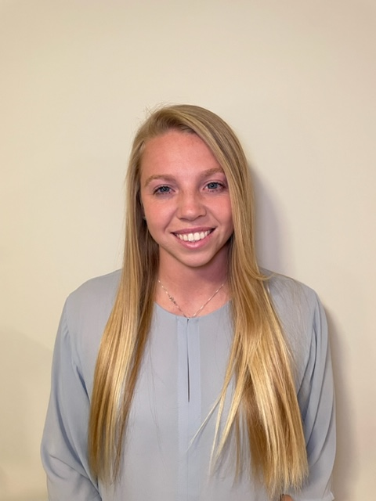
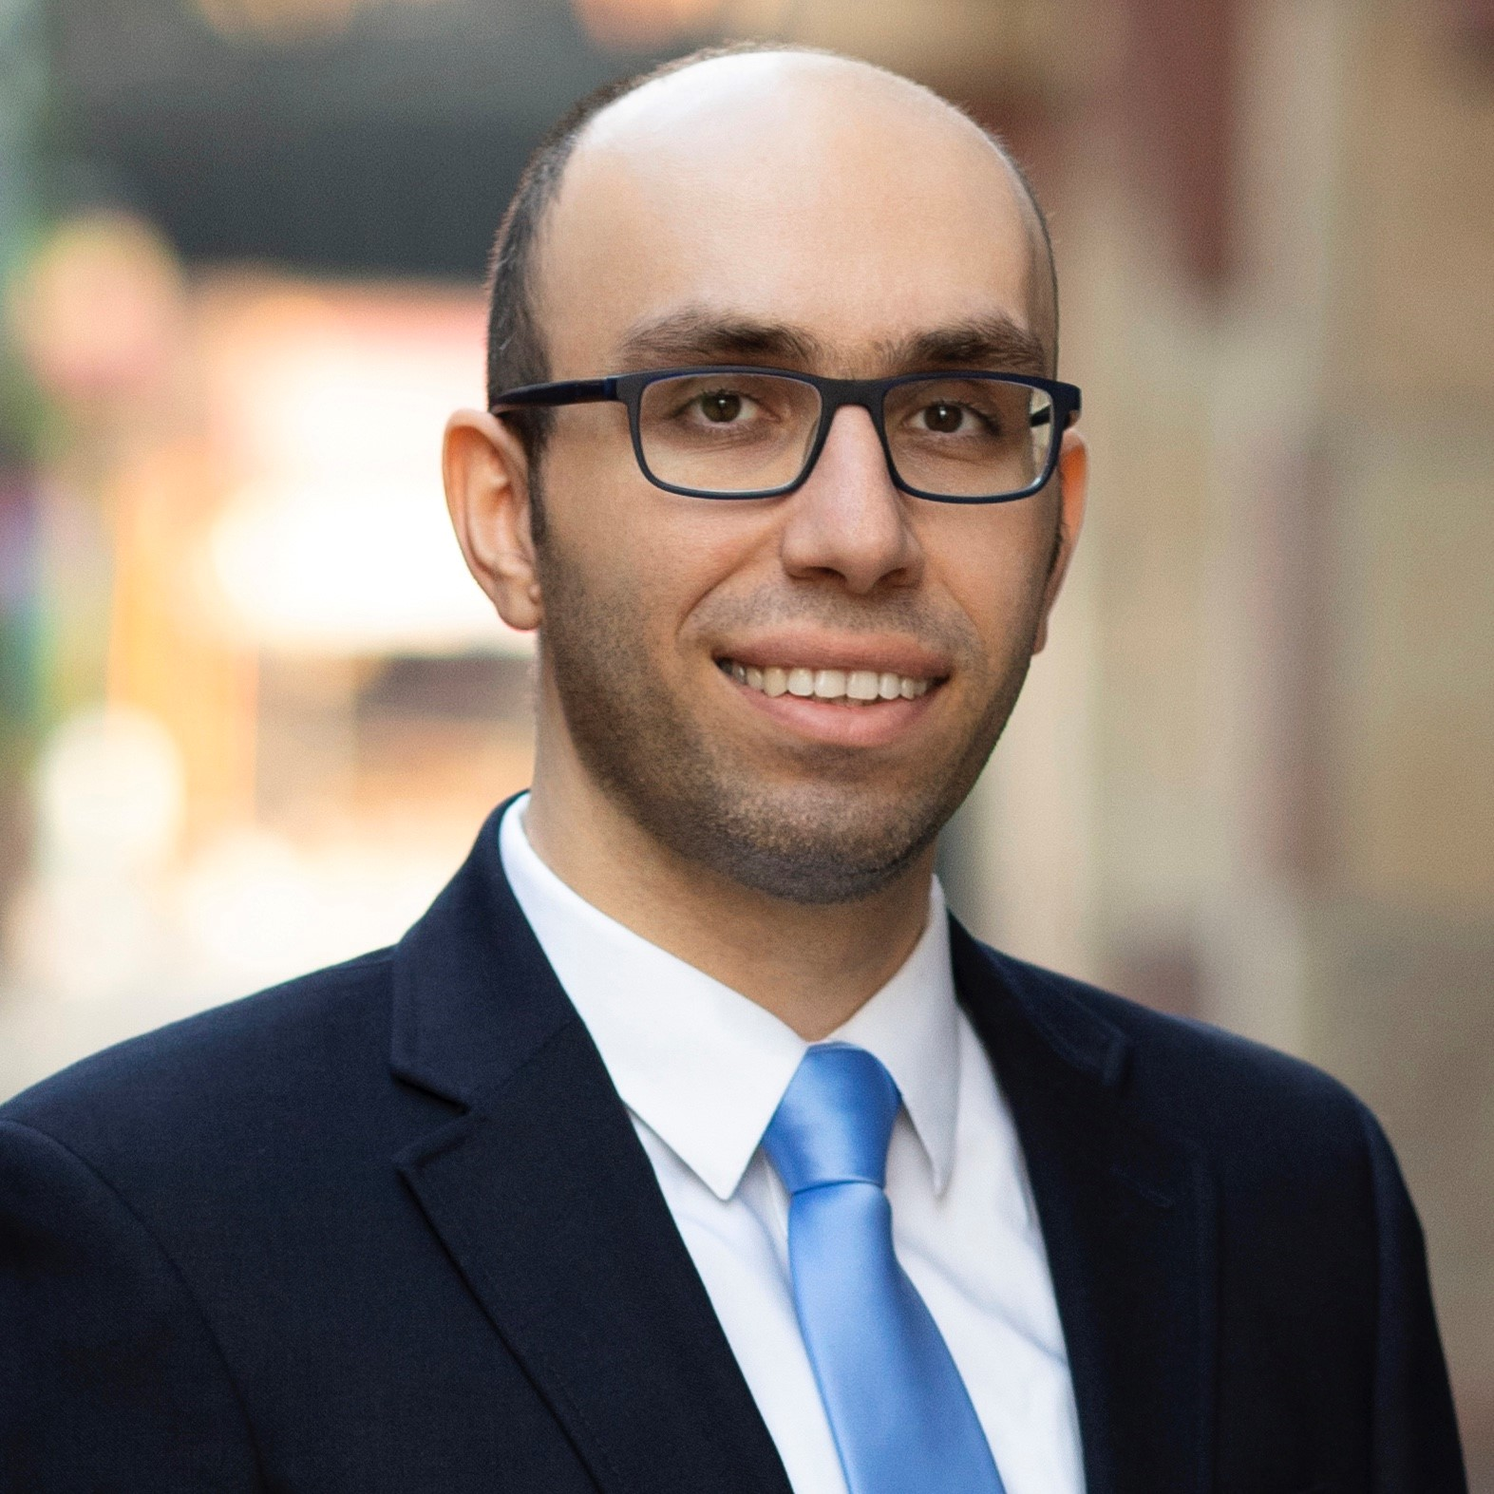
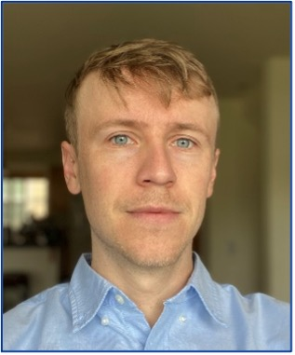
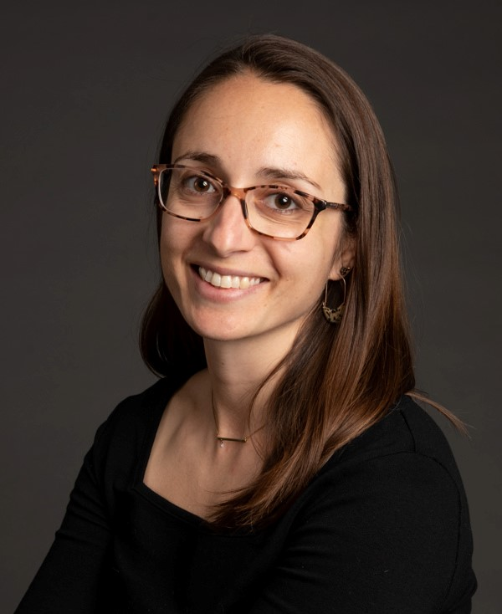
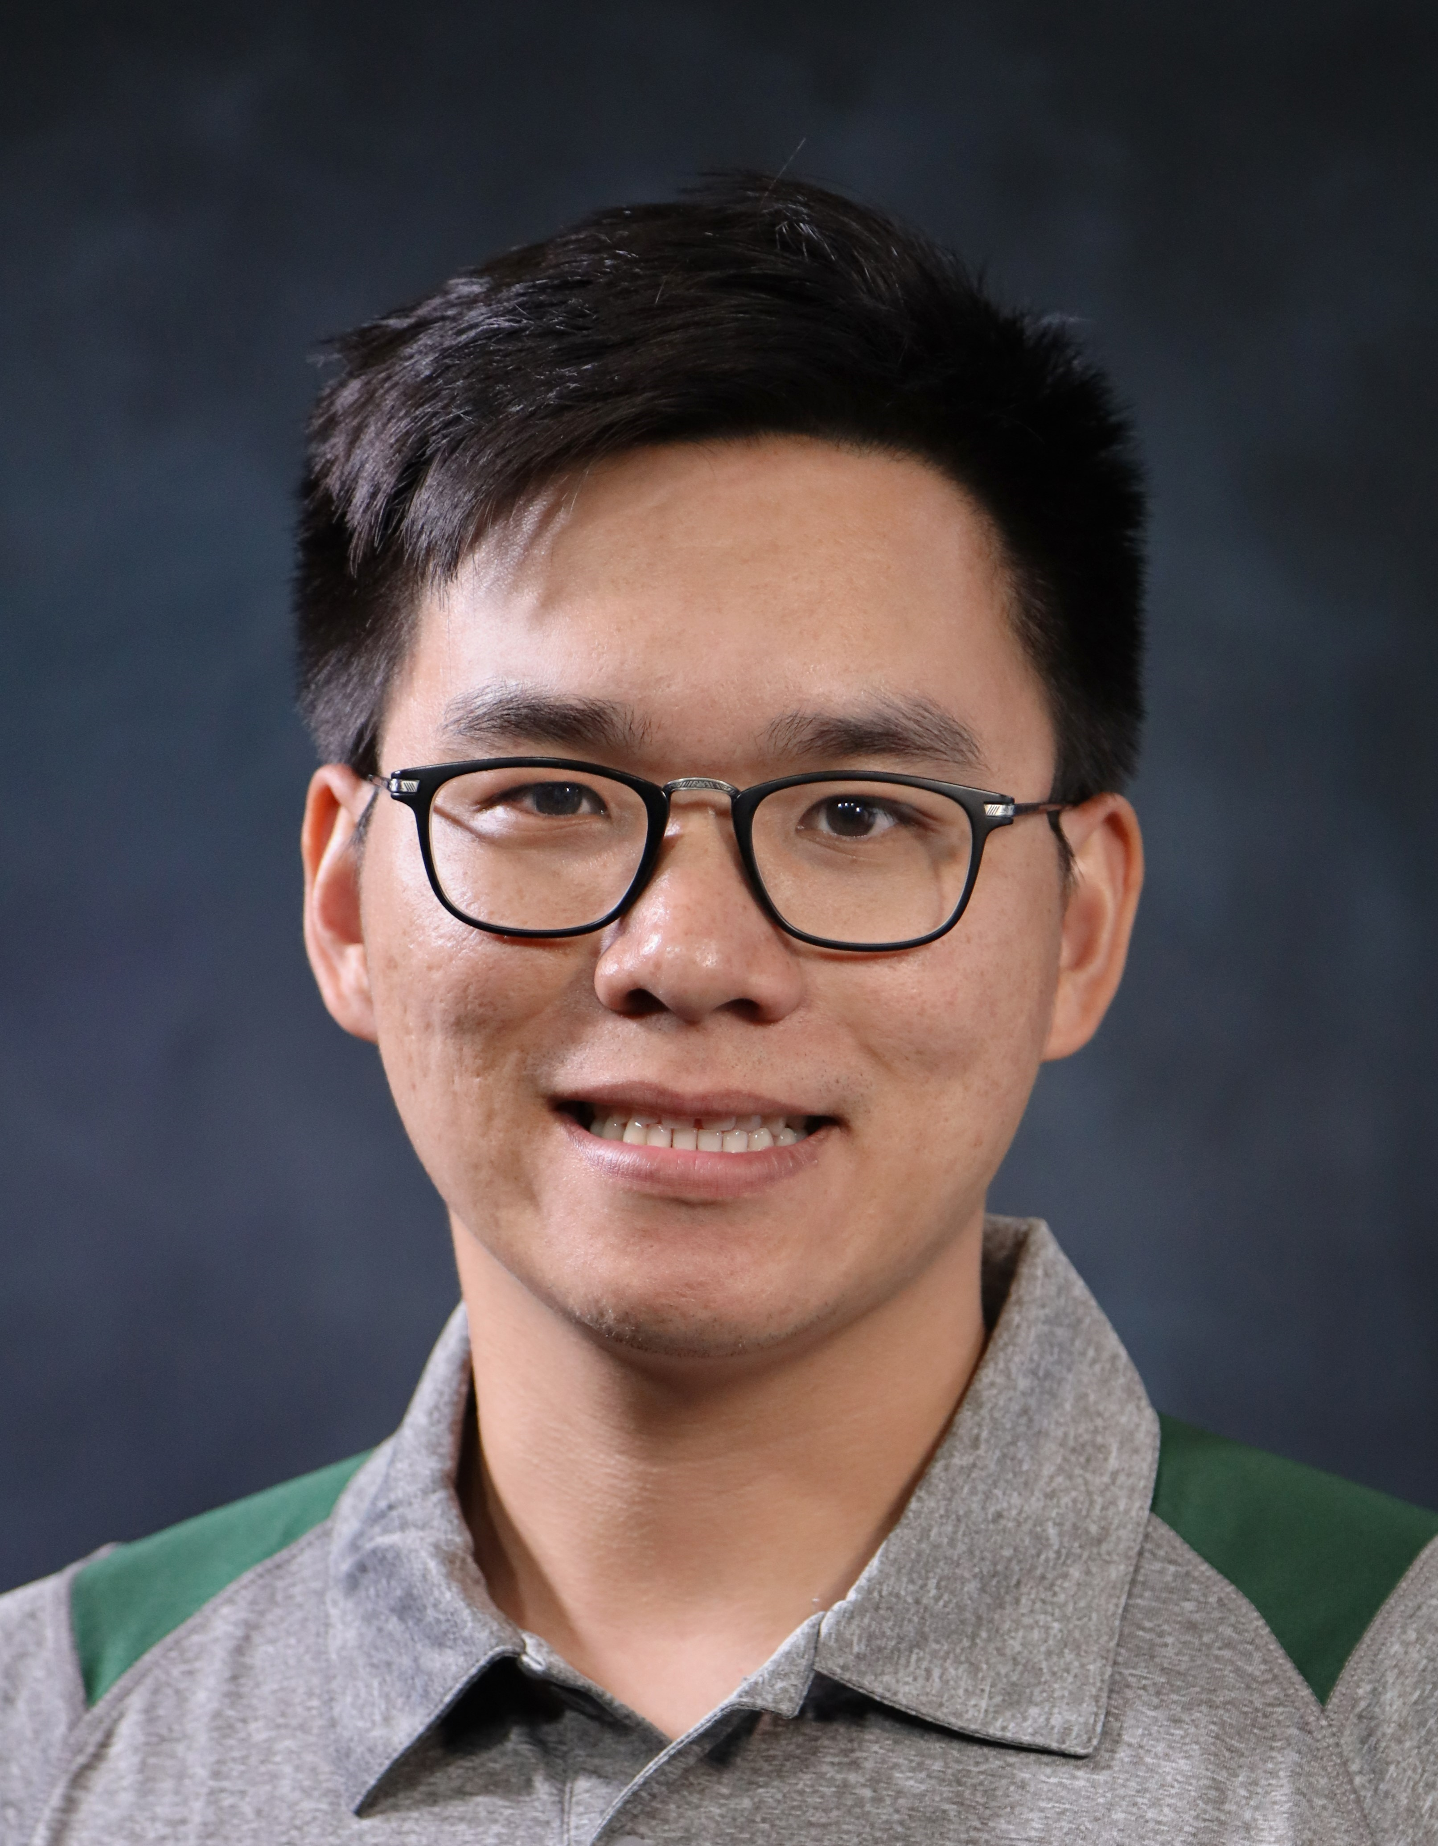
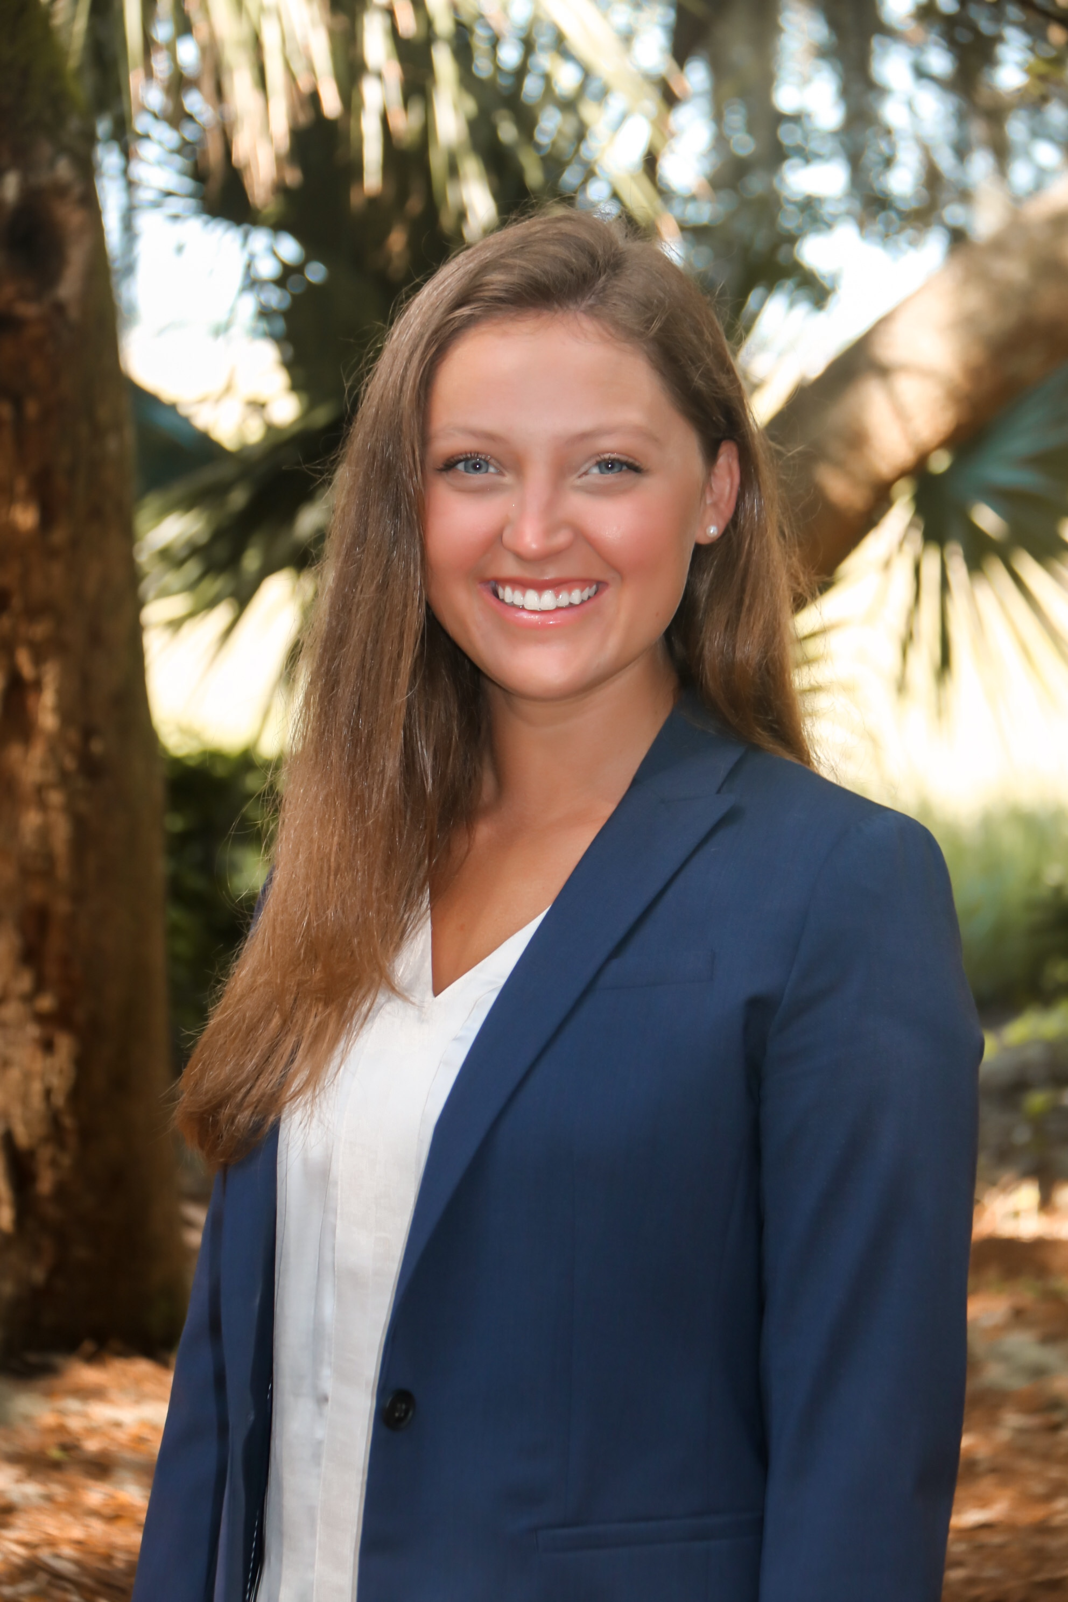
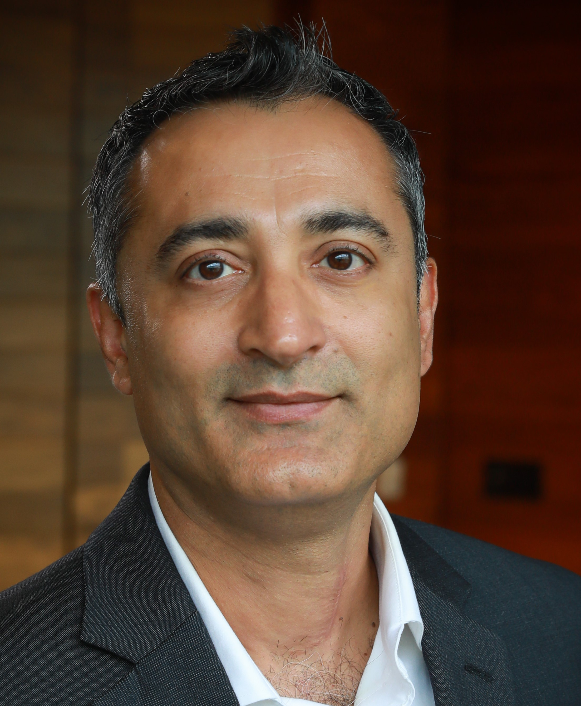
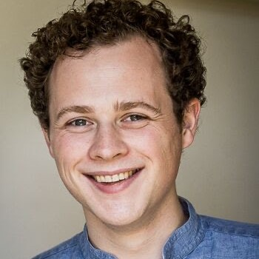
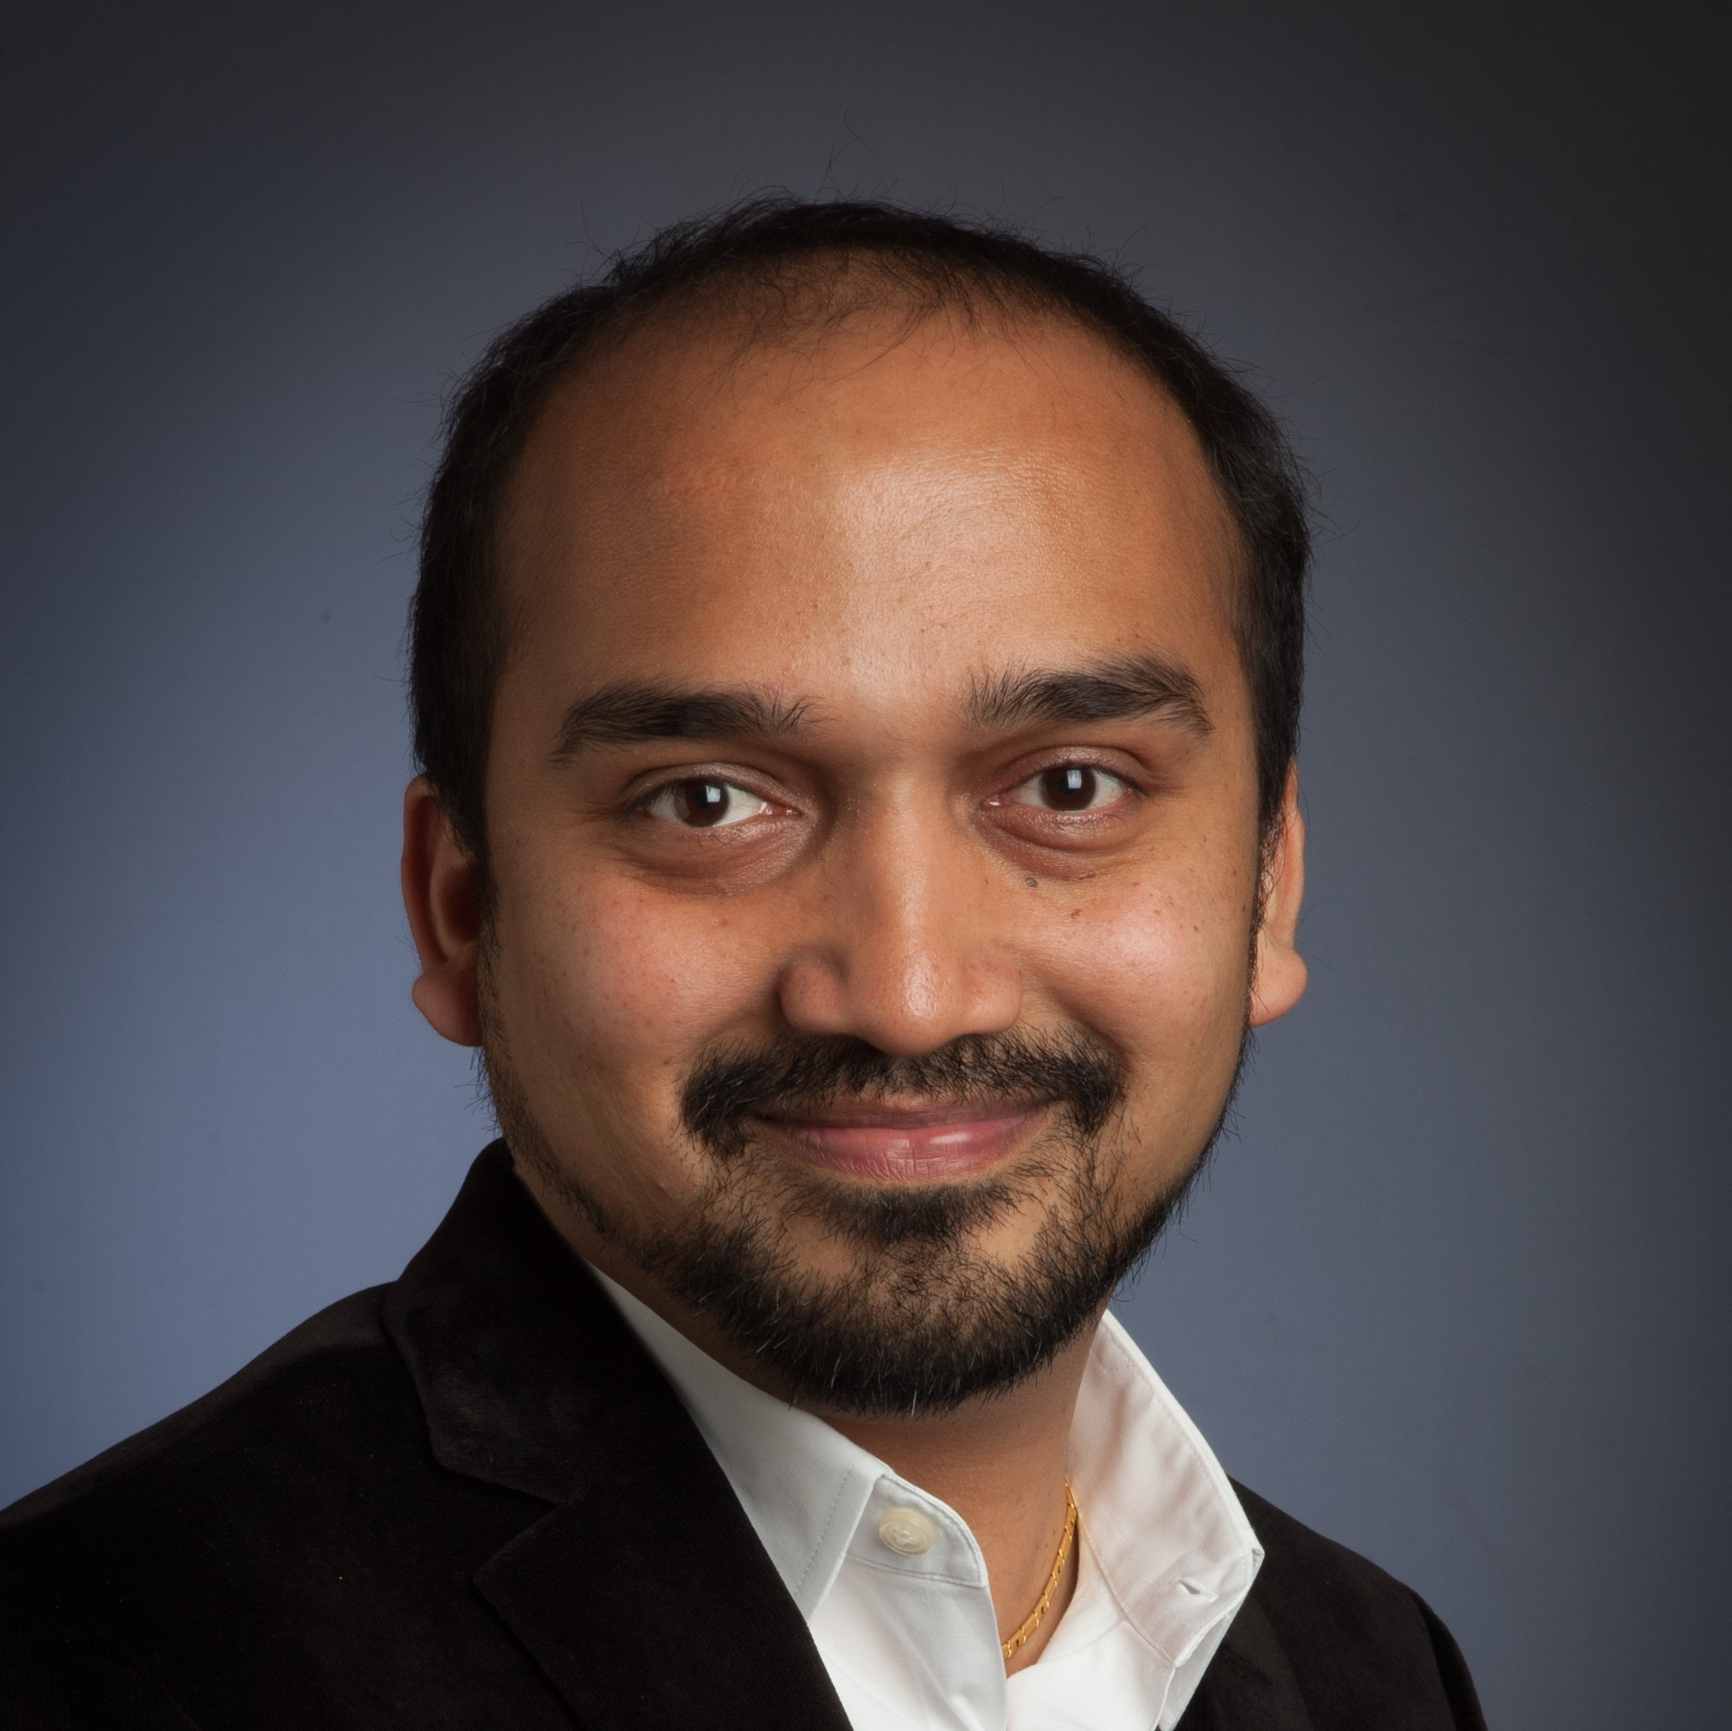

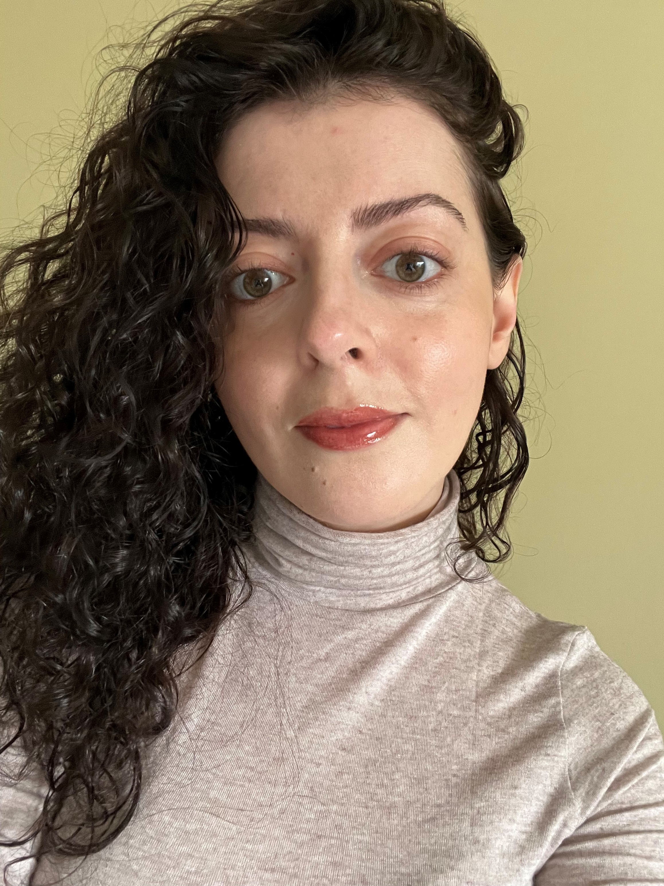
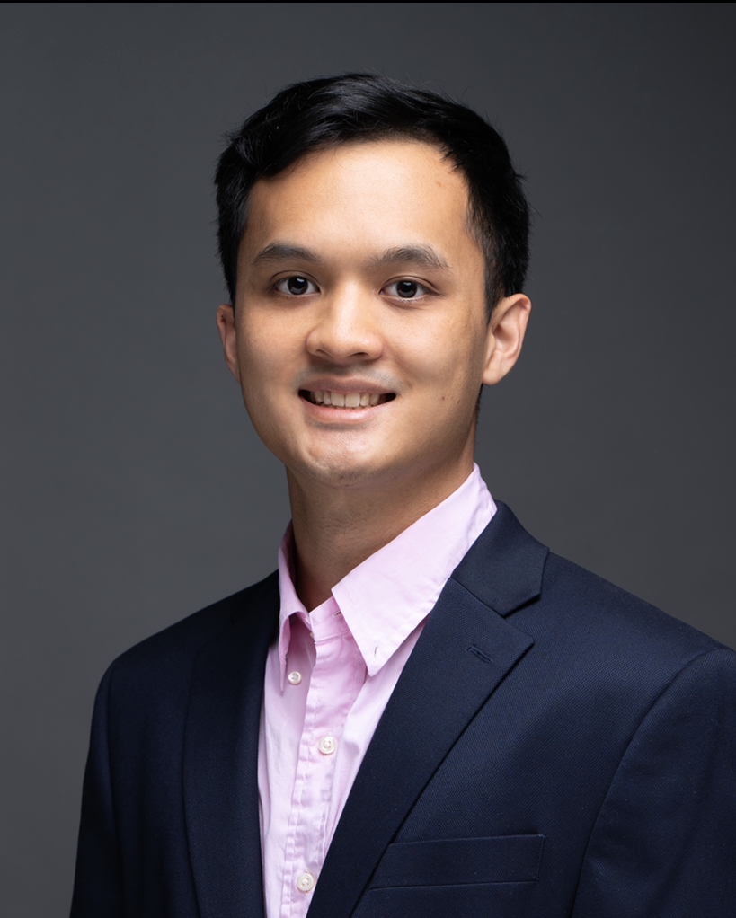
We’re excited to be your Challenge Advisors!
Team 1A
Team 1B
Team 1C
Program Support
Morgan Abbitt (She/Her/Hers)
Manager
mabbitt@kpmg.com
Hossein Kalantar (He/Him/His)
Senior Associate hkalantar@kpmg.com
Alex Voet (He/Him/His)
Senior Associate
avoet@kpmg.com
Jessica Curley (She/Her/Hers)
Lead Specialist
jcurley@kpmg.com
Sam Tan (He/Him/His)
Senior Specialist samtan@kpmg.com
Maci Williams (She/Her/Hers)
Senior Associate maciwilliams@kpmg.com
Parth Dave (He/Him/His)
Manager
pdave@kpmg.com
Jim Leach (He/They)
Director
jimleach@kpmg.com
Nirut Zaveri (He/Him/His)
Director
nzaveri@kpmg.com
Khoi Dao (He/Him/His)
Associate
khoidao@kpmg.com
Dorina Mitre (She/Her/Hers)
Associate
dmitre@kpmg.com
Notes:
They will introduce themselves when you meet them as your challenge advisor.
8 challenge advisors
3 program support
Everyone brings a different set of skills, experience, and expertise to support you.
Why this slide is important:
Lets the students know who you are and what you do
Guidance on filling in / presenting this slide:
Replace the placeholder image in the circle with a picture of yourself
Rather than a professional headshot, consider uploading an appropriate photo of yourself doing something you enjoy (e.g., hiking, traveling)
Use your professional (work) email address, not your personal email address
Add in details about any other Challenge Advisor using the second placeholder. If there is only one Challenge Advisor, the other image placeholder and text box may be removed. If there are more than 2 Challenge Advisors, copy/paste the placeholders to add additional photos/details.
During the meeting with your student team: After introducing yourself, ask each team member to introduce themselves, including: their name, preferred pronouns (which you can note down for future reference), the college they attend, what they’re majoring in, and what they’re most excited about learning during AI Studio

Slide 3
1
2
Session Agenda
3
4
5
6
KPMG overview
Who is sponsoring your AI Studio challenge
Challenge Overview
Challenge statement, business problem, expectations
Data overview
Donation data, Sociodemographic data
Machine Learning Approach
Methodology, libraries
Project Milestones
Process approach, milestone 1 expectations
Next steps: what to expect
Milestone 2-3 expectations logistics

Slide 4

KPMG Overview
Notes:
Jess

Slide 5

KPMG Company Overview
KPMG is one of the world’s leading professional services firms and the fastest growing Big Four accounting firm in the United States. With 75+ offices and more than 40,000 employees and partners throughout the US, we’re leading the industry in new and exciting ways. Our size and strength make us much more agile and responsive to changing trends.
KPMG's core values are Integrity, Excellence, Courage, Together, and For Better.
KPMG’s mission statement: "To inspire confidence and empower change“.
KPMG aims to build trust and provide insightful advice to its clients
Notes:
Why this slide is important:
Helps put the Challenge Project in context by helping students better understand their “host company”
Guidance on filling in / presenting this slide:
Provide some basic info about your company and, if you’d like, the department you’re associated with (e.g., Data and AI)
Consider the following (some of this you might choose to talk through in your meeting rather than listing out on the slide itself):
What industry does your company operate in? Professional services (audit, tax, advisory)
How long has it been around? KPMG dates back to 1897 when the accounting practice was established in the United States.
How big is your company? KPMG is one of the Big Four accounting firms. It has over 219,000 employees globally
Where does it have offices? 147 countries and territories.
What is its mission statement? "To inspire confidence and empower change" - KPMG aims to build trust and provide insightful advice to its clients.
Is it B2B, B2C, nonprofit? KPMG is a business-to-business (B2B) professional services firm serving corporations, governments, and non-profits.

Slide 6


Your project was developed by University Innovation Programs (UIP) and Lighthouse
UIP is a part of Data Citizens with Purpose
Lighthouse
Mission
Provide university students with experiential learning opportunities that will enhance their digital literacy, as they explore future careers.
Mission
To drive innovation and digital transformation by leveraging data, analytics, and artificial intelligence, enhancing client services and outcomes.
Objectives
Improve the quality, quantity and diversity of university candidates applying to KPMG
Prompt students to solve real-world, sustainability themed problems using leading practice data and analytic concepts and technology
Prepare students to convey their analytic findings through storytelling instruction
Objectives
Integrate advanced analytics, AI, and machine learning capabilities across KPMG's service lines, aiming to provide clients with innovative, data-driven insights and solutions that address complex business challenges.
To establish and maintain a leadership position in the digital and technological space by continuously evolving and expanding expertise in data science and engineering, ensuring KPMG remains at the forefront of industry innovation and client service excellence.
Notes:
Jess – UIP
Jim – Lighthouse

Slide 7
Challenge Overview

Slide 8
AI Studio Challenge Project Overview
CHALLENGE SUMMARY
Given the donation history of individual households and corporations to a non-profit organization, use machine learning to predict the likelihood of future donations. This will help the client gain insights into their donor base, better understand donor behavior, and effectively target future outreach efforts.
YOUR TEAM’S OBJECTIVE
Develop a machine learning model that can accurately predict the likelihood of future donations from individual donors or corporations.
Perform comprehensive exploratory data analysis (EDA) to uncover insights and trends in the donor data.
Engineer relevant features and create donor profiles by joining and transforming the donor data and ACS sociodemographic data and uncovering important features for your model.
DESIRED OUTCOMES
The final presentation should demonstrate your ability to apply data science techniques, derive meaningful insights from data, and provide practical, actionable recommendations to drive business value for the client organization, C5LA. The relevant data, code, presentation, and additional supporting materials should be posted to GitHub.
Notes:
While much of this deck is presented, know that we will be sharing this with you afterwards as a resource.
We recognize its wordy, but we want you to have everything you need to work independently.
[read through]

Slide 9

Business context on the background of your capstone
C5LA, a 501(c)(3) nonprofit, has a mission to change the odds for high-potential teens from under-resourced communities by inspiring them to pursue personal success, while preparing them for leadership roles in school, college, work, and their communities within the greater Los Angeles area.
They accomplish this through programming focused on youth leadership, mentorship, and professional development support for high school, college and young professionals.
To further its mission, C5LA would like to analyze donor and giving trends to better understand their donor base and help target future outreach.
Notes:
The problem you’re solving today comes from some real donation data from a nonprofit called C5LA
They have an imperative to understand the donation patterns so they can better target future outreach.

Slide 10
Final Presentation Expectations
A live, virtual 25-35 min presentation and accompanying slide deck that:
Includes an Executive Summary that defines the problem statement and their proposed recommendation
Leverages data visualizations to detail the data trends and insights
Describes the machine learning model used to predict the likelihood of future donations, including
Model selection choice
Model parameters
Model metrics
Outcomes
Contains an actionable recommendation from the ML output for targeting donations or understanding the donation patterns for C5LA
Properly cites the tools, methodologies, and sources used for the final product
**Prepare for the Q&A session at the end of the presentation**
Notes:
This is your final presentation expectations
Why this slide is important:
Helps the students understand what the project is about, its objectives, and expected outcomes
Sets the stage for the rest of the presentation
Guidance on filling in / presenting this slide:
Ensure the summary is straightforward and the objectives and desired outcomes are achievable
Do not deviate too much from your original Challenge Project submission – but do feel free to make changes (on this slide and on the following slides related to data set, milestones, etc.) based on what you learned while reviewing the “Guidance for filling in this template” slide at the beginning of this deck.
You’re welcome and encouraged to add more slides following this one to cover things like:
Ethical considerations
Learning opportunities for the students
Individual work vs. team-based work

Slide 11
Data Overview

Slide 12

Data overview
You are provided with three datasets via a KPMG Secure File Transfer Protocol site to download the data. Data dictionaries are also provided for all datasets.
 | Donation Data | ACS Sociodemographics | County to Zip Code Crosswalk
Format | .xlsx | .xlsx | .xlsx
Data types | Numerical and Categorical | Numerical and Categorical | Categorical
Approx. Size | 200 KB | 40,000 KB (0.40 GB) | 41,700 KB (.41 GB)
Notes:
We’re providing 3 datasets
You’ll have access through our Secure File transfer protocol site
They’re relatively small and you can open them via excel or csvs

Slide 13
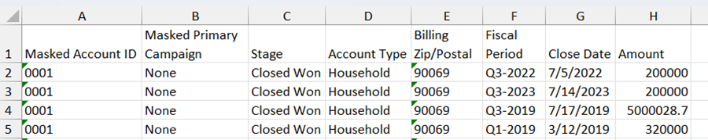
Dataset 1 – Donation Data
Filename: DonationsC5LA.xlsx
A tabular dataset containing information about one-time and recurring individual household or corporate donors. Data is created from Salesforce and reformatted for simplicity. Attributes include:
Unique donor ID
Donation amount
Donation date
Donor zip code
Donation campaign name

Slide 14
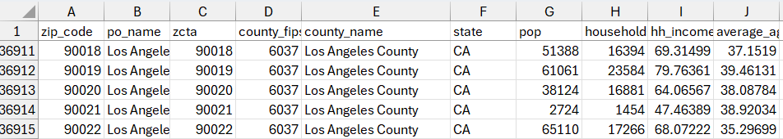
Dataset 2 – ACS Sociodemographic Panel
Filename: ACSSociodemographics.xlsx
A single dataset that contains socioeconomic details by zip code, from the American Community Survey (ACS) from the Census Bureau. Attributes include:
Household income
Population
Education level

Slide 15
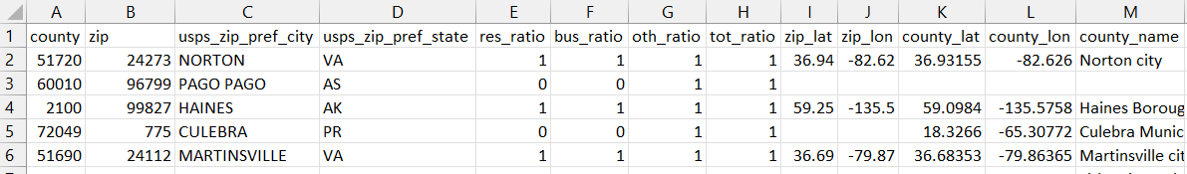
Dataset 3 – County to Zip Code Crosswalk
Filename: us_geo_county_to_zip.xlsx
Each row contains a 5-digit State County FIPS code mapped to a corresponding 5-digit USPS Zip code.
Use this file in conjunction with the ACS data to uncover trends at a county level
There are valuable data available only at the ZIP code level that, when combined with demographic data at various Census geography levels, could open new areas of exploration.
Notes:
Why this slide is important:
Students often struggle at the beginning of their project if dataset details are not clear and comprehensive
Guidance on filling in / presenting this slide:
Include a screenshot of the data if possible
Most importantly: Don’t forget to provide a link to download the dataset!

Slide 16

Data Access Instructions
Download the datasets and accompanying data dictionaries from the Secure File Transfer Protocol site (SFTP site): BTT AI Studio 2024
Instructions:
Go to https://kmft.us.kworld.kpmg.com/
First Time login: Use your username and temporary password emailed to you to log in.
- Change your temporary password for future logins.
- Sign up for the two-factor authorization process when prompted
Download the files for use on your challenge project
Save a master copy of the originals (in case you corrupt the file)
Delete any unused files at the end of your semester
Note: Files are deleted from the SFTP after 7 days, on August 20! We will reupload again next week.
If you need to access the files again, let your challenge advisor know.
Notes:
You will get an email with your username, and another email with your password. Your username is likely your email address
. Your password will be temporary and expect you to create a new password

Slide 17
Machine Learning Approach
Notes:
Jim to take this section

Slide 18
Suggested ML approach
Recommend a supervised learning approach
Binary Classification: can you predict whether a donor will donate again?
Regression analysis: can you predict how much a repeat donor will donate
Example algorithms include: logistic/linear regression (for binary and regression modes); random forest, gradient boosting, k-nearest neighbors
Evaluation metrics should be selected based on your approach, but could include: accuracy, precision, recall, F1 score (classification); mean squared error, mean absolute error, or mean absolute percentage error
Also consider how to leverage interpretable models that can identify the important factor(s) in making your prediction
Notes:
Why this slide is important:
Provides a starting point for students who are new to AI/ML and have not worked on a project like this before
Guidance on filling in / presenting this slide:
Try to be as specific as possible here, so the students have a good understanding of the problem space and where to begin
Remember that the students will likely have limited experience with unsupervised learning, NLP, and deep learning
During the meeting with your student team: Consider pausing here to ask if the students have any questions

Slide 19

Python libraries
pandas – working with ‘rectangles’ (tables) of data
geopandas – working with geospatial data
scikit-learn – leveraging ML algorithms
plotnine or seaborn – data visualization
matplotlib – more data vis.
Notes:
Why this slide is important:
Recommendations for specific Python libraries will save the students time and effort at the outset of their project, and help them build confidence since they’ll know where to start in terms of researching and importing relevant libraries
Guidance on filling in / presenting this slide:
During the meeting with your student team: Explain why the suggested libraries are appropriate for the project, and what each one is for. Remember that while all the students have hands-on Python experience, some may still be getting used to using it in practice.

Slide 20

Suggest Dev and PM tools
Suggested development tools: VS Code, Google Colab
Version control software: Git & Github
Project Management: GitHub board / issues
Suggested frameworks: Scrum (sprints) or Kanban
Notes:
Why this slide is important:
Ensures the students use industry-standard tools (and ones that you are familiar with and can help them use)
Guidance on filling in / presenting this slide:
Please only suggest free tools to avoid the students needing to pay out of pocket (which is not within scope of our program)
During the meeting with your student team: Talk about how you use the suggested tools, methods, and frameworks in your professional life
Reminder: Most students will be expecting to use Google Colab to access free GPUs and do collaborative development work (and this is also our preference given the success we’ve seen with previous cohorts using Google Colab). We’d like all student teams to use GitHub; please encourage this when you meet with them!

Slide 21

Helpful resources
C5LA website: https://www.c5la.org/
Python for Data Analysis
storytelling with data
https://www.statlearning.com
R for Data Science – written for R, but a good overview of common data science workflow steps
Notes:
Why this slide is important:
Provides the students with additional learning materials that can help add context and inspire them
Guidance on filling in / presenting this slide:
Curate (free) resources that are relevant and helpful
Avoid recommending in-depth courses that will take students away from core project work (e.g., don’t recommend a multi-week Deep Learning Coursera course)

Slide 22
Project and Milestones
Notes:
Jess do this section

Slide 23
Project milestones and timeline
These are the milestones for your Challenge Project. They are roughly aligned to the CRISP-DM process you learned about in your ML Foundations course.
Monthly “Maker Days”
Monthly “Maker Days”
Monthly “Maker Days”
Session 1
September 7
Session 2
October 5
Session 3
November 2
Submission Deadline
TBD
Welcome & Introduction
Final
Presentation
December 5-6 2024
BTT / KPMG Kick-Off
August 14
(Bi)weekly Meetings
August-December
Notes:
Speaker Notes
Here is a glance of the project timeline

Slide 24



Suggested Process Approach
2. Get familiar with the data
Review the available data and reports and understand how they tie to each other. Read the data dictionaries. Save all necessary data for your team to work on.
3. Clean and prepare the data
Clean, transform, join, and group the data to answer your problem statement. Perform Exploratory Data Analysis (EDA) to understand the shape and trends in the data. Define your target variable(s).
Understand the business problem
Internalize the challenge statement and prompt, and conduct additional research on the client and their needs. Brainstorm how you can provide a practical and reliable solution to the client. Define your criteria for success.
4. Data analysis and modelling
Using data analysis and ML processes find trends in the data related to the problem statement and business issue. Ensure you have a training and testing set. Select techniques to develop a machine learning model that can accurately predict the likelihood of future donations.
5. Validate and enhance
Test your model against reasonable model metrics. Ensure your results are interpretable and reasonable. Does your model result meet the business success criteria?
6. Finalize your product
What are your predictions on unseen data? What is the donor profile of a repeat donor? Define the process, your model parameters, its metrics, and why you chose that model for your solution?
7. Put it together in a presentation
Present a compelling presentation that clearly states the problem, your solution, how it meets the criteria for success. Your presentation should be client-facing.
Notes:
Why this slide is important:
Helps students understand and focus on specific tasks related to the first project Milestone that you have defined for them
Guidance on filling in / presenting this slide:
Modify this Example slide to fit your Milestone #1 (which might be something different than Data preprocessing)
During the meeting with your student team: Encourage students to work both independently and as a team (e.g., each student conducts their own dataset exploration). This will help ensure that all team members get in the habit of contributing to the project’s success from the outset.

Slide 25
Milestone 1 Expectations
3. Clean and prepare the data
Clean, transform, join, and group the data to answer your problem statement. Perform Exploratory Data Analysis (EDA) to understand the shape and trends in the data.
Understand the business problem
Internalize the challenge statement and prompt, and conduct additional research on the client and their needs. Brainstorm how you can provide a practical and reliable solution to the client. Define your criteria for success.
2. Get familiar with the data
Review the available data and reports and understand how they tie to each other. Read the data dictionaries. Save all necessary data for your team to work on.
4. Data analysis and modelling
Using data analysis and ML processes find trends in the data related to the problem statement and business issue. Ensure you have a training and testing set. Select techniques to develop a machine learning model that can accurately predict the likelihood of future donations.
5. Validate and enhance
Test your model against reasonable model metrics. Ensure your results are interpretable and reasonable. Does your model result meet the business success criteria?
6. Finalize your product
What are your predictions on unseen data? What is the donor profile of a repeat donor? Define the process, your model parameters, its metrics, and why you chose that model for your solution?
7. Put it together in a presentation
Present a compelling presentation that clearly states the problem, your solution, how it meets the criteria for success. Your presentation should be client-facing.
Notes:
Why this slide is important:
Helps students understand and focus on specific tasks related to the first project Milestone that you have defined for them
Guidance on filling in / presenting this slide:
Modify this Example slide to fit your Milestone #1 (which might be something different than Data preprocessing)
During the meeting with your student team: Encourage students to work both independently and as a team (e.g., each student conducts their own dataset exploration). This will help ensure that all team members get in the habit of contributing to the project’s success from the outset.

Slide 26
Understand the problem
MILESTONE #1 TASKS
Some specific questions to consider are:
What trends can be observed in one-time donors based on their account type, donation amount, close date, and zip code?
How have one-time donation trends shifted over time? Is there a specific time of the year when the most donations are made?
Are there any location-based trends in one-time donations? Can you identify locations where the largest one-time donations are coming from?
What trends can be identified in recurring donors based on their account type, donation amount, close date, and zip code?
What percentage of the donor base consists of recurring donors, and how often do they give year over year?
Is there a difference in donation amounts between one-time and recurring donors?
Do certain campaigns correlate with one-time or recurring donations? Which campaigns were the most and least successful in terms of donor participation and donation amounts?
Based on the provided data, can you predict the likelihood that a donor will make future donations?
Notes:
Why this slide is important:
Helps students understand and focus on specific tasks related to the first project Milestone that you have defined for them
Guidance on filling in / presenting this slide:
Modify this Example slide to fit your Milestone #1 (which might be something different than Data preprocessing)
During the meeting with your student team: Encourage students to work both independently and as a team (e.g., each student conducts their own dataset exploration). This will help ensure that all team members get in the habit of contributing to the project’s success from the outset.

Slide 27
Understand the Data
MILESTONE #1 TASKS
Review the data overview slides (in this document)
Read the data dictionaries
Data is provided in flat files (.xlsx, .csv)
Save the data in a reliable format
Ensure you can read it into your program
Relate the data to the problem
Note the data types
What does the data mean?
Check your bias
Are there outliers?
Conduct Exploratory Data Analysis (EDA): calculate measures of center and spread, identify outliers, count number of instances, etc.
Real world data contains missing values, its not a mistake! Consider how to account for these (imputation, exclusion, etc.)
Notes:
Why this slide is important:
Helps students understand and focus on specific tasks related to the first project Milestone that you have defined for them
Guidance on filling in / presenting this slide:
Modify this Example slide to fit your Milestone #1 (which might be something different than Data preprocessing)
During the meeting with your student team: Encourage students to work both independently and as a team (e.g., each student conducts their own dataset exploration). This will help ensure that all team members get in the habit of contributing to the project’s success from the outset.

Slide 28
Data preprocessing
MILESTONE #1 TASKS
Data cleaning e.g., handling missing values, outliers, duplicates
Data transformation e.g., normalization and encoding tasks
Data Reduction if needed e.g., dimensionality reduction
Data Augmentation e.g., combine data together to form new data sets for analysis
Feature Engineering e.g., derive new columns/features from existing data that you will use in your model
Notes:
Why this slide is important:
Helps students understand and focus on specific tasks related to the first project Milestone that you have defined for them
Guidance on filling in / presenting this slide:
Modify this Example slide to fit your Milestone #1 (which might be something different than Data preprocessing)
During the meeting with your student team: Encourage students to work both independently and as a team (e.g., each student conducts their own dataset exploration). This will help ensure that all team members get in the habit of contributing to the project’s success from the outset.

Slide 29






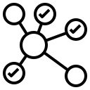
Exploratory Data Analysis
MILESTONE #1 TASKS
Look for and correct errors
Understand what the data has captured
Understand data types
.
Assess Data Quality
Calculate summary statistics
Evaluate Completeness of Data
Look for relationships within the dataset (e.g. correlation)
.
Notes:
Why this slide is important:
Helps students understand and focus on specific tasks related to the first project Milestone that you have defined for them
Guidance on filling in / presenting this slide:
Modify this Example slide to fit your Milestone #1 (which might be something different than Data preprocessing)
During the meeting with your student team: Encourage students to work both independently and as a team (e.g., each student conducts their own dataset exploration). This will help ensure that all team members get in the habit of contributing to the project’s success from the outset.
This is a framework for investigating the data involves these 6 steps. This process can help you form a hypothesis or a better understanding of the data to answer your problem statement.
Overall, your goal is to get a general understanding of the shape and make up of the data.
Errors- like 3 digit zips
Data Types: are they categorical as text, or numerical? Are they the right types of numbers?
Completeness: are there fields or rows with missing data? How do you fill a cell if its missing information?
What’s captured? Is it a count? An average? A percent? Is it over 1 year or is it a point in time?
Summary stats: what is the range of the data? The average? The median, mode, outliers? Type of distribution
Correlation: do values have a relationship

Slide 30
What to expect: Next steps
Notes:
Jim Speak to

Slide 31
Iterate: Build and evaluate your model We will review more detail as we approach Milestone 2 after the 2nd Maker Day
MILESTONE #2 TASKS
First: Define your model metrics and how you will measure “success”
Decide on appropriate model(s) to test
Set up your model testing approach e.g., cross validation or test/train split etc.
Execute your test – train your models and measure their success!
Refine parameters
Retrain / retest and iterate
Select your “best” model(s) and measure their success
Notes:
Why this slide is important:
Helps students understand and focus on specific tasks related to the given Challenge Project Milestone(s)
Guidance on filling in / presenting this slide:
Make additional copies of this slide if desired
Modify each slide to fit your Milestone(s)

Slide 32
Put it all together in a final presentation
MILESTONE #3 TASKS
The final presentation should demonstrate your ability to:
Apply data science techniques
Derive meaningful insights from data
Provide practical, actionable recommendations to drive business value for the client organization, C5LA.
The relevant data, code, presentation, and additional supporting materials should be posted to GitHub.
Presentation
Executive Summary / Problem Statement
Donor profiles & important donor features
ML selection and methodology
Model metrics and measures of success
Translate the above into actionable recommendations for targeting donors and driving value for C5LA
Data model
Working code repository
Explanation of methodology
Explanation of model metrics and evaluation criteria
Notes:
Why this slide is important:
Helps students understand and focus on specific tasks related to the given Challenge Project Milestone(s)
Guidance on filling in / presenting this slide:
Make additional copies of this slide if desired
Modify each slide to fit your Milestone(s)

Slide 33
How we’ll work together this semester
Check-in meetings | Fortnightly+ (e.g. may do extras later in the project) Team to provide agenda or priority discussion items as needed
Reporting | Report during each check-in meeting including accomplishments, planned activities, and blockers/items that need to be discussed as a team
Communication | Likely a mixture of Slack, email, or through GitHub. Please work out directly with your challenge advisor(s)
Tools and platforms | VS Code, Google Colab, Git, and GitHub; Teams/Zoom!
Other project norms | Can vary a lot(!) Scrum or Kanban good to adopt, but discuss as a team and with your advisors to find what feels best for you
Notes:
Jim
Why this slide is important:
Sets clear expectations and working norms
Provides a sense of structure for the students, which is something they are used to from their college courses
Gives the students the opportunity to practice “ways of working” that they’ll be expected to follow in their summer internships and full-time jobs
Guidance on filling in / presenting this slide:
Fill in each of the 5 rows to the best of your ability
During the meeting with your student team: Ask the students when they’ll be available to meet with you for their regular (every 2 weeks) check-in meetings. They will have discussed availabilities amongst themselves beforehand.

Slide 34
How to get started
Here’s what we suggest for your immediate next steps. We’ll follow up on your progress and help address any challenges in our next check-in meeting:
Review & ask
We’ll email you a copy of this deck to store in your Google Drive project folder. Review it as a team and note down any questions you’d like to discuss in our next meeting.
“Scope and Deliverables”
As a team, work on this required Break Through Tech assignment before and during your Sept 7th Maker Day. You’ll review it in your next meeting with your Challenge Advisor
Next Steps
Check your access to the datasets in the SFTP
Set up the Dev/PM tools
Get familiar with the datasets
Do research on the problem & C5LA
Meet your advisor(s)!
Notes:
Why this slide is important:
Ensures students know how to proceed and get started on their project over the coming weeks
Guidance on filling in / presenting this slide:
Use the pre-created text in the first two boxes
Note: The “Project Scope and Deliverables” document is a required Break Through Tech assignment that the students will submit to us on September 8th via their Canvas course. They will also share it with you and their AI Studio TA for feedback to make sure they have properly documented the project scope and goals.
Use the third box to add any additional next steps

Slide 35

Questions?
What questions do you have?
Anything I can help clarify?
What are you most excited about?
Anything you’re unsure about?
Notes:
Questions they may ask:
Impact of the work
Slack/email is best way to communicate
Let us know if their challenge advisor doesn’t get in touch with them
Why this slide is important:
Making time for questions will allow the students to ask for clarification on their project goals and next steps!
Guidance on filling in / presenting this slide:
On this slide are some suggested prompts; feel free to replace these with your own (or remove them and just verbally ask if they have any questions)
Remember to email this deck – and ideally also a meeting recording – to the students after the August 14th meeting, so they can reference it as they work on their Project Scope and Deliverables assignment!

